Slide 1
A comprehensive framework to research digital innovation: The joint use of the systems of innovation and critical realism (Um quadro abrangente para a investigação da inovação digital: A utilização conjunta dos sistemas de inovação e do realismo crítico) (Authors: Arturo Vega & Mike Chiasson)
Trabalho de grupo da disciplina Metodologias de Investigação
ISEG, Universidade de Lisboa
Doutorando: Nuowei Wang（王挪威）
Email: corn.dean@163.com
10 de outubro de 2023

Slide 2
Introduction
1.Research background: Business strategy increasingly depends on the pervasive and instrumental role of digital innovations to create competitive advantages for firms and whole industrial sectors. We adopt a systemic and holistic view of digital business strategy to represent and study the form and dynamics of the external sociotechnical environment that matters for organizations .
2.Research contribution: By proposing a framework composed of SIs as a conceptual base and alternative unit of analysis, which posits innovation processes in society as intricate and multilevel systems of actors, activities and institutions. We also propose CR as the philosophical stance and provider of research approaches to study the structure and evolution of SIs.
3.Research structure
Expound the opportunities for the study of digital innovation.
Explaining SIs and how to formulate SI-based units of analysis in the ambit of digital innovation, as well as pointing out some related deficiencies in SI research practice.
Move on to CR and demonstrate the compatibility between SIs and the ontology of CR.
Explain and exemplify the study of information systems innovation diffusion based on SIs and critical realist approaches.
Formulate a set of relevant research questions to guide the study of digital innovation through SIs and CR.

Slide 3
The need to expand digital innovation research
1.Concept of digital innovation (Nambisan et al., 2017, p. 224): the creation of (and consequent change in) market offerings, business processes, or models that result from the use of digital technologies.
2.The need to expand digital innovation research
Research in this area is more engaged with organizationally digital innovations than with distributed and decentralized innovation processes and outcomes (Sorensen and Landau, 2015).
Extant research is targeting the focal actor [(e.g. a platform owner or the adopters of an innovation)] .
The external environment has become so relevant that it can shape the focus of entire studies.
Due to the concentration on focal innovators, there are also few studies on the evolution of complex sociotechnical systems (e.g. de Reuver et al., 2018; Tilson et al., 2010; Tiwana et al., 2010).
Distributed innovation entails new forms of risks, in environments with several contradictory logics and marked resistance to change.
Now, much of IS research has been explicitly or implicitly based on the sociotechnical systems approach (Hirschheim and Klein, 2011).
And so on...

Slide 4
Systems of innovation
1.Concept of innovation: SIs is a conceptual base to understand and explain innovation processes in society (c.f. Cooke et al., 1997; Freeman, 1987; Nelson, 1993). It was developed under the foundation of general systems theory, evolutionary economics and institutional economics (e.g. Edquist, 2005; Soete et al., 2010). According to SIs, innovation is about producing, diffusing and using new knowledge or novel combinations of new or existing knowledge.
2.Innovation is a collective achievement of different actors from the public, private and third sectors, who through their reflectivity, creativity and capacities realize innovations (research and development, competence building, the formation of new product markets...)
3.The institutional environment plays a key role in innovation, because it influences the performance of actors by laws, regulations, common practices, routines, habits, trust, etc.
4.Core to SIs is the concept of boundaries, the boundaries of an SI are defined from the research and identification of the causal components of innovation processes at different levels of society.
5.The distinction between radical and incremental innovations is central to understanding change.

Slide 5
The SI as an alternative unit of analysis in digital innovation research
1.Scholars have defined diverse types of SIs, and research has mostly concentrated on distinctive topics depending on each type. SIs can be classified according to three aspects: geography, sector and technology (e.g. Carlsson et al., 2002; Edquist, 2005; Hekkert et al., 2007; Malerba, 2004).
Geographical SI: regional (tacit, face-to-face interaction, mutual trust and shared values), national (innovation-related policies, non-firm organizations, infrastructure and resources) and transnational SIs (innovation among regions of different countries).
Sectoral SI: the activities, actors, institutions and relations that directly affect performance and transformation, as well as the division of labor between industrial sectors.
Technological SI: the establishment of technological paradigms to materialize innovation and business opportunities.

Slide 6
Critical realism
1. Concept of critical realism: CR (c.f. Collier, 1994; Danermark et al., 2002; Sayer, 2000) is a metatheory, originally developed from a general philosophy of science called transcendental realism (Bhaskar, 1997) and a more specific human science philosophy called critical naturalism (Bhaskar, 1998), by adding an interpretive thread to a deep ontological stance primarily conceptualized from the natural sciences (Sayer, 2000).
2. 3 Domains of CR. CR states that there are three domains of reality. The domain of the empirical relates to our experiences, the domain of the actual relates to the events that we directly or indirectly experience, and the domain of the real to the generative mechanisms that give rise to these and other related events (Bhaskar, 1997).
3. 2 Systems of social structures. In CR, structures and people are distinct phenomena which possess their own powers. As a result, there is a dual relationship in which social structures and acting people affect each other (e.g. Archer, 1995; Lawson, 1997). Archer (1995) decomposed social structures into 2 systems: (1) structural systems: associated with material relations and their emergent properties including the allocation of physical and human resources, as well as the organizations (e.g. corporate finance departments) and frameworks (e.g. employment laws) that affect the relations. (2) cultural systems: about the relations of ideas and their emergent properties including the preponderance of theories, norms, beliefs and values, as well as the organizations (e.g. internal communications areas) and frameworks (e.g. history) that affect the relations.

Slide 7
CR as an ontological base of SIs
1.There is a clear compatibility between the SI framework and CR ontology. Ontology matters because it guides studies in terms of epistemology and research approaches (e.g. Archer, 1995; Fleetwood, 2005; Reed, 2009).
Compatibility shows in:
Both frameworks depict reality as macrostructures that are constituted of a multiplicity of components, relations, multilevel emergence of powers and the subjectivity of people to give life to the social realm.
There is also compatibility in relation to generative mechanisms (Castellacci, 2006). CR produces general abstractions to represent the operation of mechanisms since the domain of the actual is contextually heterogeneous and intricate (Sayer, 1992).
2.There has been very little effort to connect SIs and the CR ontology.

Slide 8
Joint application of SIs and CR in digital innovation research
1.Two of the most often employed explanatory frameworks in CR research are Danermark et al.’s (2002) staged model for studying the composition of social structures and Archer’s (1995) morphogenetic approach to researching agency and structural change processes (e.g. Dobson, 2012, 2013; Raduescu and Vessey, 2008).
The staged model: Danermark et al. (2002) proposed an explanatory staged approach to research the conformation of social structures.
Description and analytical resolution: in the description stage, the aim is to form an account of the concrete events that will be a matter of analysis according to the experiences of the people involved with them. This could be undertaken using qualitative methods such as interviews with the SME decision-makers to build preliminary stories about adoption processes and factors.
Abduction/theoretical re-description: the objective in the abduction/theoretical re-description stage is to devise alternative conceptual frameworks to hypothesize the underlying structures that could explain in more general and social-level terms the events experienced by people and groups.
Retroduction and comparison between different theories and abstractions: in formal CR terms, retroduction is the guided and disciplined research movement from observable events to abstract and fundamental generative processes (Sayer, 1992).
Concretization and contextualization: an objective is to appreciate how a model works in specific and concrete situations, with the possibility of triggering further research to improve and extend the theoretical system initially abstracted (e.g. Blom and Moren, 2015).

Slide 9
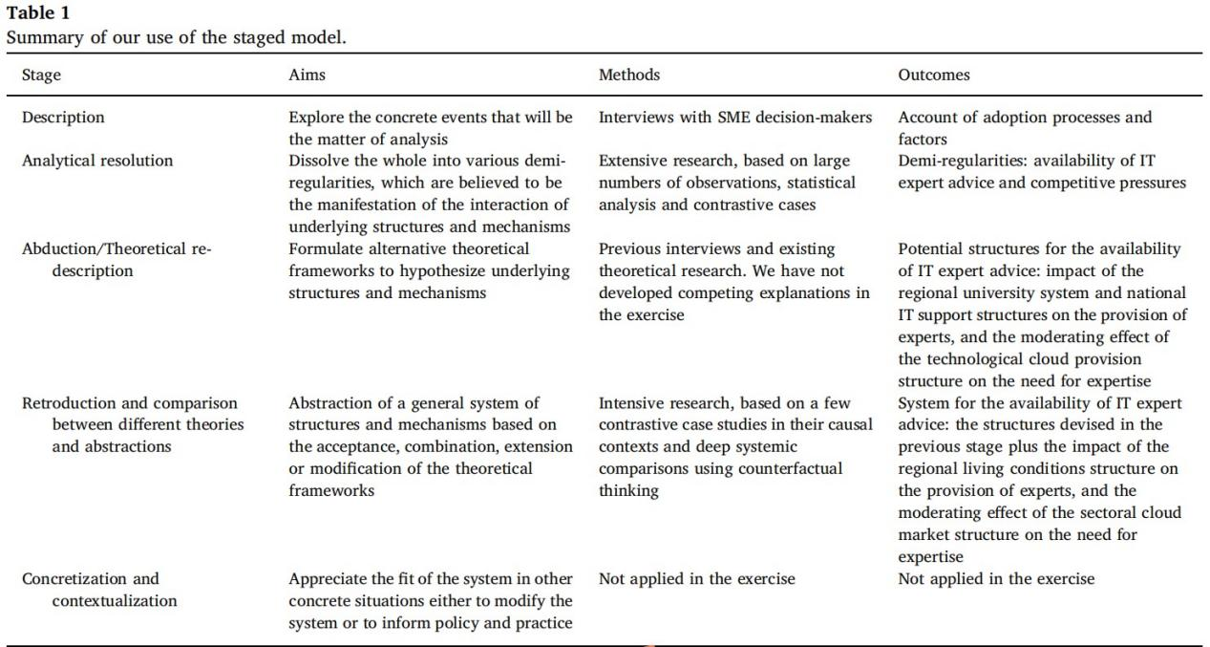
Source: Arturo, V. & Mike, C (2019). A comprehensive framework to research digital innovation: The joint use of the systems of innovation and critical realism. Journal of Strategic Information Systems 28: 250.

Slide 10
The morphogenetic approach: The morphogenetic approach (Archer, 1995) is aligned with the transformational model of social activity (Bhaskar, 1998) by considering social structures and agency as different phenomena with their own powers. Fig. 1 depicts the boundaries of the SI and expands on the outcomes shown in Table 1.

Slide 11
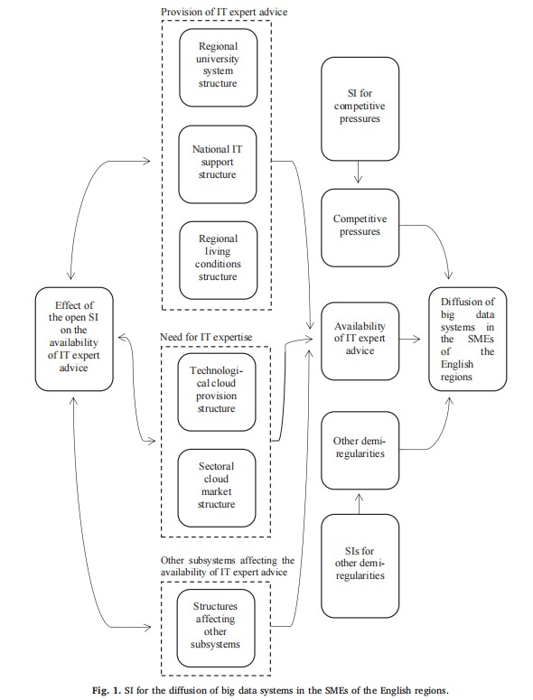
Source: Arturo, V. & Mike, C (2019). A comprehensive framework to research digital innovation: The joint use of the systems of innovation and critical realism. Journal of Strategic Information Systems 28: 251.

Slide 12
Conclusions
1.The scope of digital business strategy has been substantially extended due to its dependence on the increasingly complex external environment that affects digital innovation.
2.This study proposes a comprehensive framework to address the calls to research digital innovation in a systemic way to encompass the multilevel causes at societal levels that affect IS in organizations, as well as explain agency and how it influences the structural evolution of systems and technological change.
3.Two contributions of this paper: the first contribution is to consider SIs as an alternative and holistic conceptual base and unit of analysis to study the creation, diffusion and use of digital innovations in countries, regions, sectors and other organizational aggregations. The second contribution is the use of CR research approaches to study SIs given the compatibility between both, along with some flaws in the SI research practice, namely the lack of development of multilevel systemic theories and an over emphasis on structures to the detriment of individual agency and endogenous change.

Slide 13
Reference
1. Arturo, V. & Mike, C (2019). A comprehensive framework to research digital innovation: The joint use of the systems of innovation and critical realism. Journal of Strategic Information Systems 28: 242-256.

